Slide 1
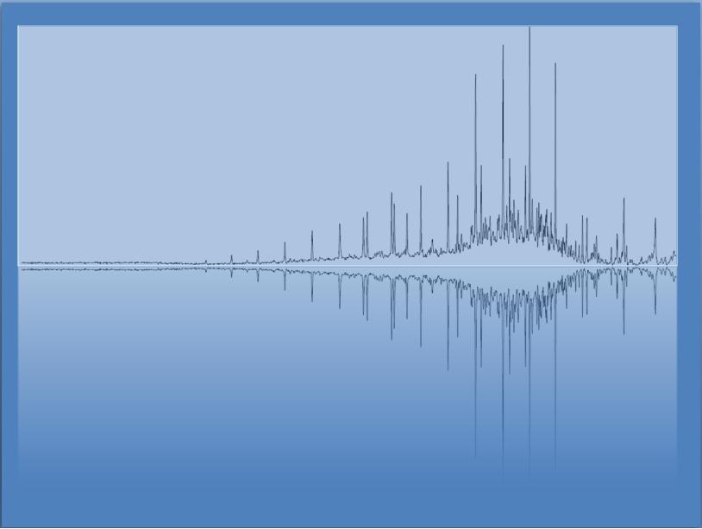
Welcome to Day 1!
Chem 3A- Yates

Slide 2
Outline
Stories & Introduction to Class Plan
Measurements, Precision, Significant Figures
Scientific Notation
Density
Unit Conversions

Slide 3
Short Stories from Seth’s College Experience
Calculus I
Physics

Slide 4
Learning Communities
One of, if not THE, most important factors in student success in College.
Groups of people working together toward a shared goal.
Your Learning Community will likely include
Faculty
Students (Peers)
Tutors
Counselors
Other College Staff

Slide 5
Interaction With Faculty
Only 20% of students who do not have out-of-class interaction with faculty.
-Dr. Frank Harris III

Slide 6
I’m hoping I can convince you that…
Reaching out to me, tutors, study group members, etc. when you need help understanding a concept (which you will), is not an option if you want to succeed.
I’ve structured the class to make many of these things required, so as not to give you the impression that they are optional.
*I may allow small adjustment to some of these requirements in specific cases, but only if you show me that you are doing what’s necessary to succeed.

Slide 7
Why?
Because I want you all to be successful!

Slide 8
Office Hours (S-275)
Mon: 12:00 – 1:15pm
Tues: 9:30 – 10:20am
Wed: 12:00 – 1:15pm
*You can usually come a little early and stay a little late.
**I often provide snacks.

Slide 9
Extending the Classroom (ETC)
Jacob Gaya

Slide 10
Study Groups
We will get to know each other in lab
…and sit together this week in lab.

Slide 11
GRASP
Fridays 9:00 am - 2:00 pm
Open Tutoring by Chemistry Faculty in S-220

Slide 12
Outline
Stories & Introduction to Class Plan
Measurements, Precision, Significant Figures
Scientific Notation
Density
Unit Conversions

Slide 13
Significant Figures
Bathroom Scale vs Lab Balance Example
(Dealing with measurement precision in
addition and subtraction)

Slide 14
Rounding Answers from Calculations
Addition/Subtraction
Round to the same place as the least precise measurement.
Multiplication/Division
Round to the same # of significant figures as least # of significant figures in problem.

Slide 15
Counting Significant Figures
All non-zero digits are significant.
“Sandwiched” zeros are significant.
1.05 has 3 significant figures.
Trailing zeros after a decimal point are significant.
1.050 has 4 significant figures.
Leading zeros are NOT significant.
0.001050 has 4 significant figures.
Trailing zeros before a decimal point
are significant if decimal is shown 120. 3 s.f.
are not significant if decimal is not shown 120 2 s.f.

Slide 16
Determine the Number of Sig Figs
0.0035 m
1.080 g
2371 L
1 dozen = 12

Slide 17
Determine the Number of Sig Figs
0.0035 m 2 significant figures—leading zeros are not significant.
1.080 g 4 significant figures—trailing and interior zeros are significant.
2371 L 4 significant figures—All digits are significant.
1 dozen = 12 Unlimited significant figures—Definition

Slide 18
Rounding Answers from Calculations
Addition/Subtraction
Round to the same place as the least precise measurement.
Multiplication/Division
Round to the same # of significant figures as least # of significant figures in problem.

Slide 19
Example Problems
35.45 mL – 30.5 mL =
103.37 g/20.5 mL

Slide 20
Example Problem Answers
35.45 mL – 30.5 mL = 4.95 mL = 5.0 mL
103.37 g/20.5 mL = 5.042439 g/mL = 5.04 g/mL

Slide 21
Outline
Stories & Introduction to Class Plan
Measurements, Precision, Significant Figures
Scientific Notation
Density
Unit Conversions

Slide 22
Scientific Notation (Do on board)
Key- Remember that:
Large exponents are for numbers bigger than 1
500 = 5 x 10²
Small exponents are for numbers smaller than 1
0.005 = 5 x 10⁻³

Slide 23
Outline
Stories & Introduction to Class Plan
Measurements, Precision, Significant Figures
Scientific Notation
Density
Unit Conversions

Slide 24
Density
Done in lab ☺

Slide 25
Outline
Stories & Introduction to Class Plan
Measurements, Precision, Significant Figures
Scientific Notation
Density
Unit Conversions

Slide 26
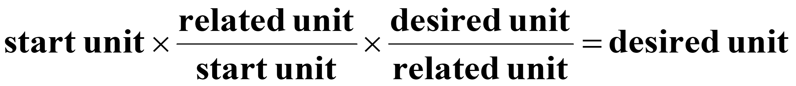
Unit Conv./Dimensional Analysis
Conversion factors are relationships between two units, generated from equivalence statements.
e.g., 1 inch = 2.54 cm
Arrange conversion factors so the starting unit cancels.

Slide 27
Common Prefixes in the SI System
Prefix | Symbol | Decimal Equivalent | Power of 10
mega- | M | 1,000,000 | Base x 10⁶
kilo- | k | 1,000 | Base x 10³
centi- | c | 0.01 | Base x 10⁻²
milli- | m | 0.001 | Base x 10⁻³
micro- | μ | 0.000 001 | Base x 10⁻⁶
nano- | n | 0.000 000 001 | Base x 10⁻⁹
*The prefixes in blue must be memorized.

Slide 28
Example
Convert 3.2 gallons to milliliters (mL)
Step 1: Write starting number and unit on left and desired on right.
Step 2: look up conversions involving gallons and mL. (For now, write them separately first.)
Step 3: Put the conversions into the problem in steps so that the starting unit cancels and you end up with the final unit you want.

Slide 29
Do In-Class Worksheet

Slide 30
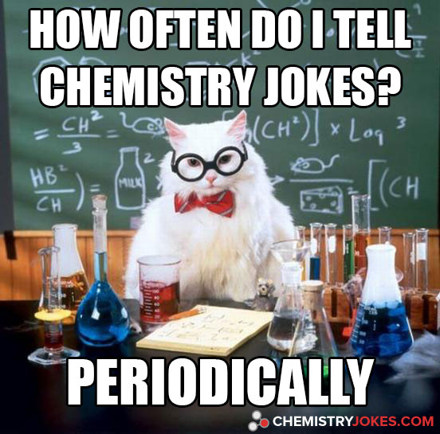
Chemistry Joke

